Slide 1
2024-06-19_S06-S07-S08-S09
Sxx_Icell_t1800_Cxxxx_J01
Gottfrid Olsson

Slide 2
Goals with this session
Investigate what values of deposited capacity of Li can be measured in the SEM for the I-cell (for good passivation, t=1800s)
How even the deposition is in the I-cell
Test the suggested data acquisition scheme (e.g. 9 or 16 images evenly spaced in the circle of deposited Li)

Slide 3
I’ll try 10kV3.0nA

Slide 4
S06_Icell_t1800_C0001_J01; (1 muAh/cm2)

Slide 5
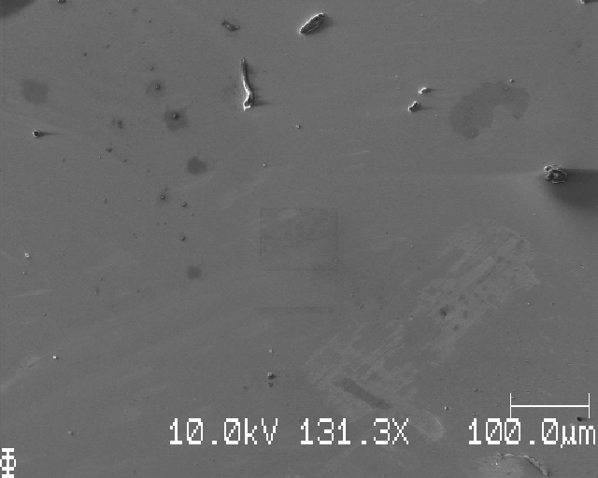
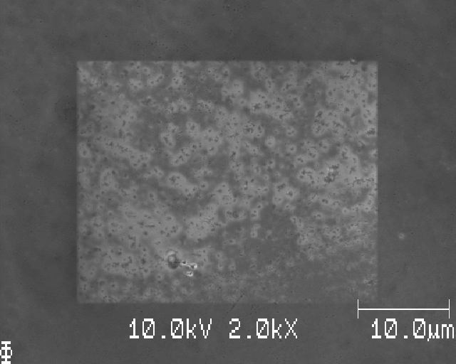
S06_M1 (matrix-position 1 of 9)

Slide 6
S06_ due to lack of Li, take only M1, M5, M9 (but the program crashed before taking M9)

Slide 7
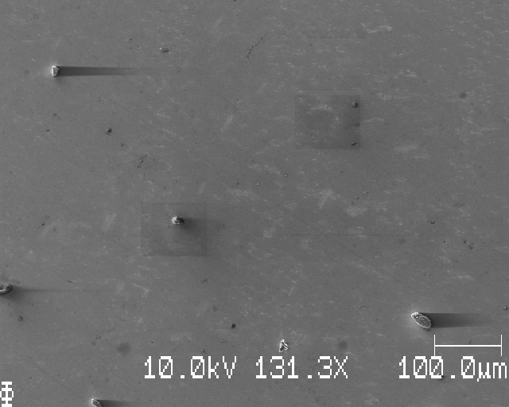
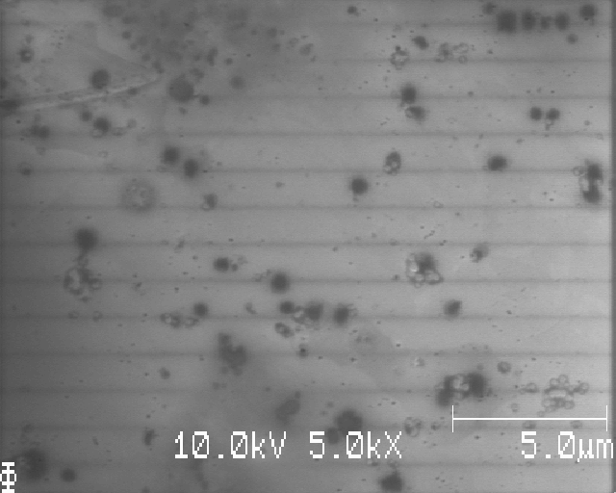
S06_M5; bubbles when zooming in…

Slide 8
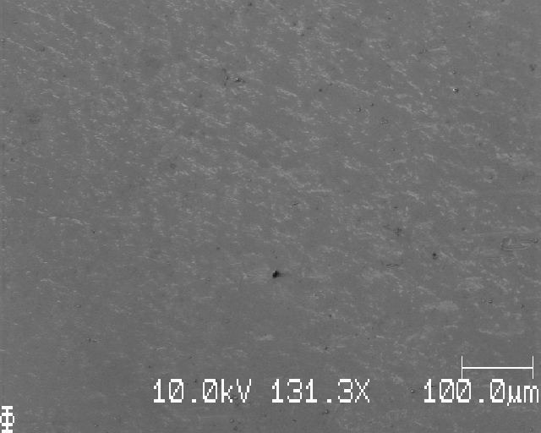
S06 close to middle; hard to claim that there is Li here

Slide 9
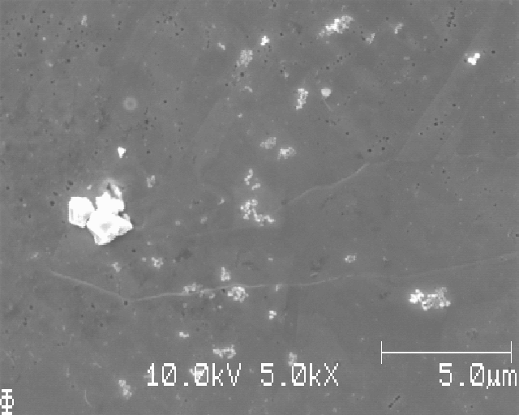
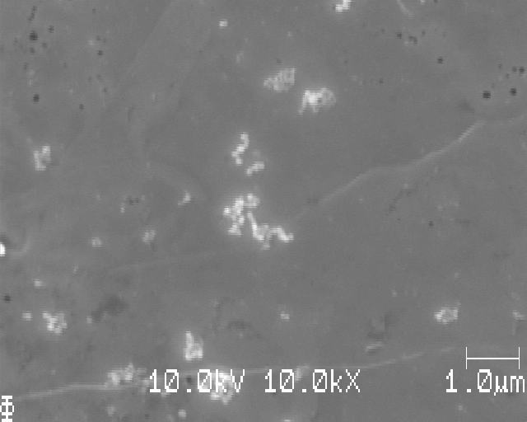
S06; closer to edge, maybe Li, maybe not

Slide 10
S06: learning points
Hard to say if we can see C0001 from this measurement

Slide 11
S07_Icell_t1800_C0003_J01; (3 muAh/cm2)

Slide 12
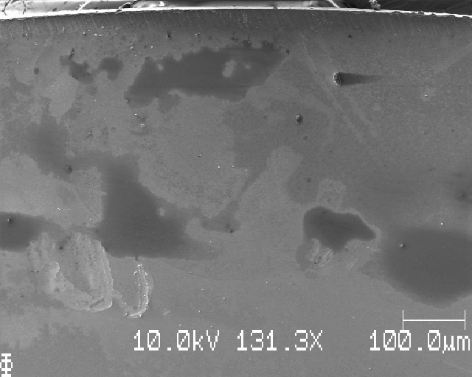
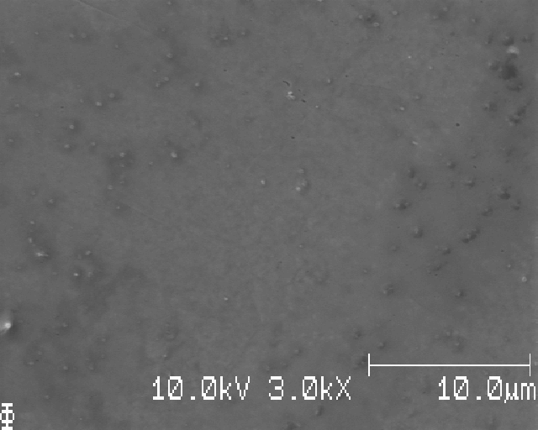
S07: top edge

Slide 13
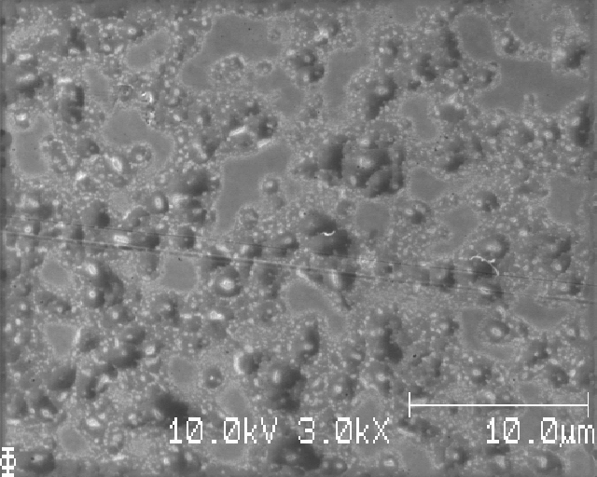
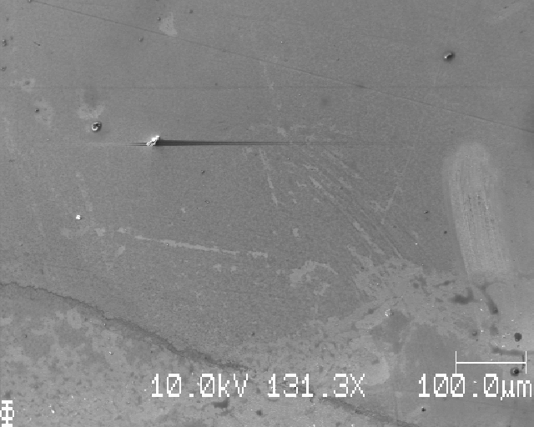
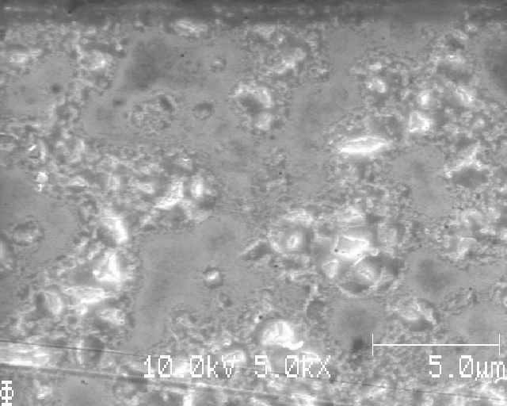
S07; below; bubbled when zoom-in…

Slide 14
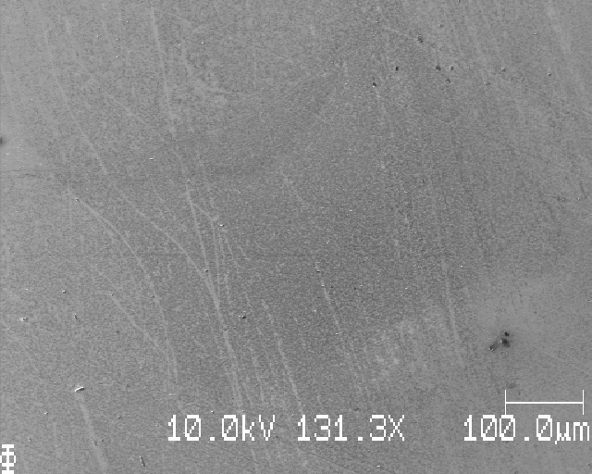
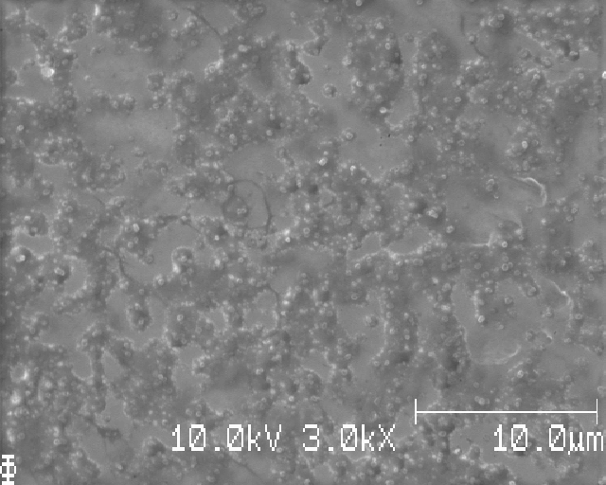
S07; further down; again bubbles when zoom-in…

Slide 15
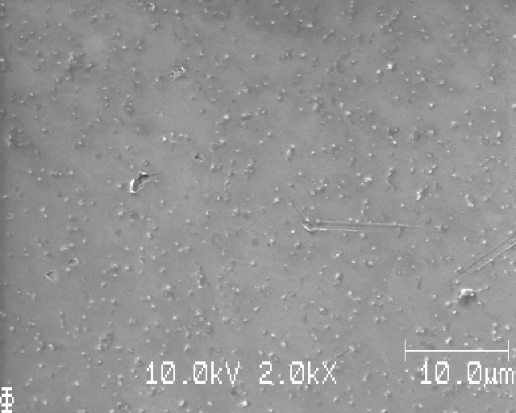
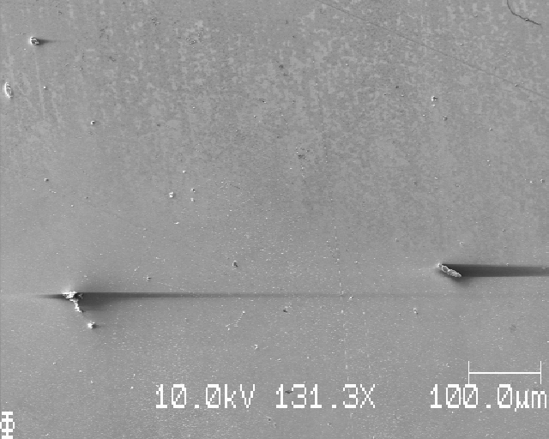
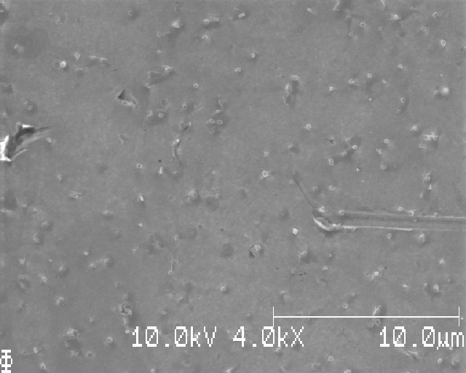
S07; further down; no bubbles

Slide 16
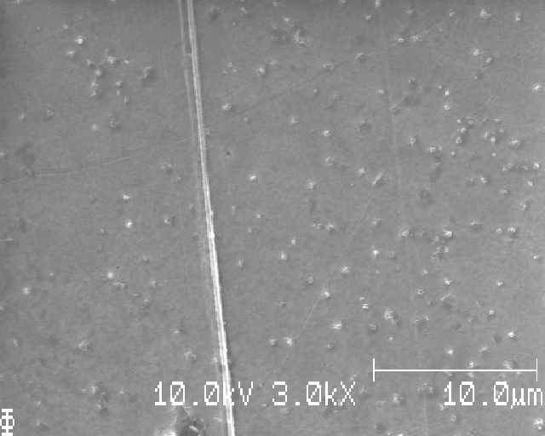
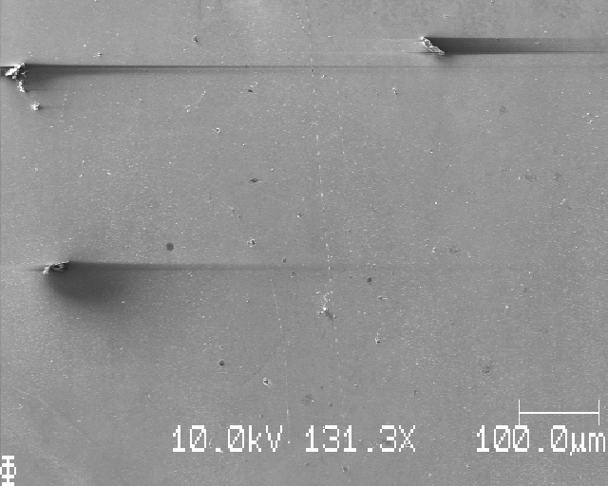
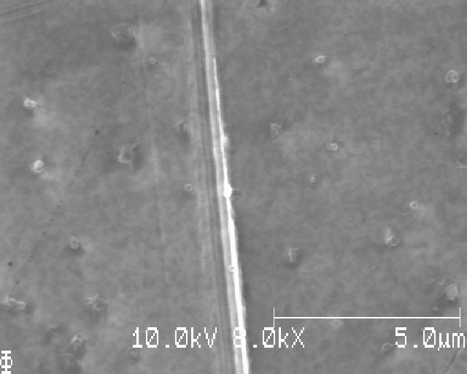
S07; below

Slide 17
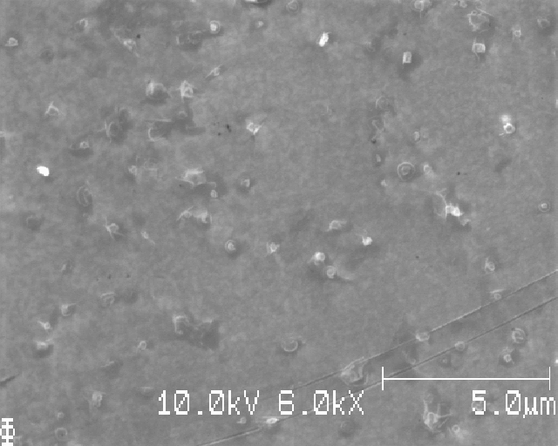
S07; Li? Or smth else…

Slide 18
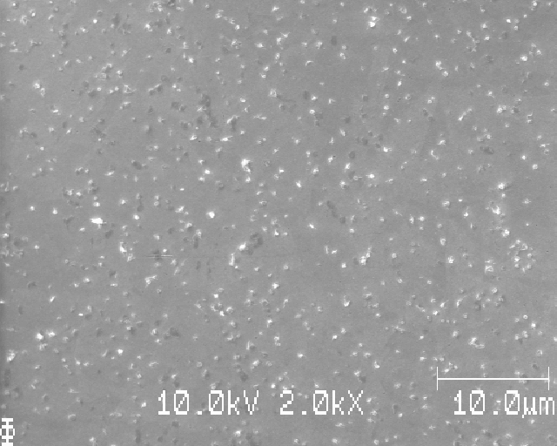
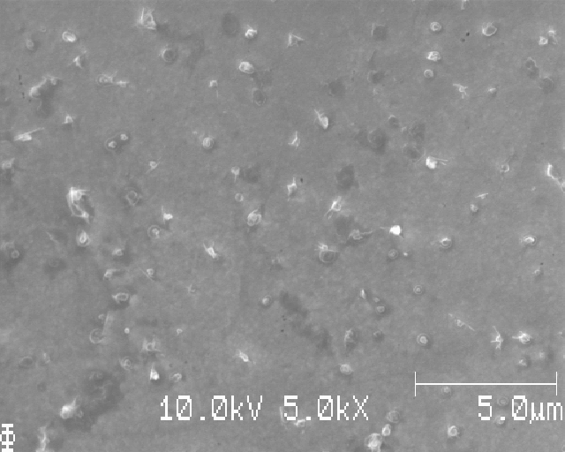
S07; another place; white=Li?, dark spots

Slide 19
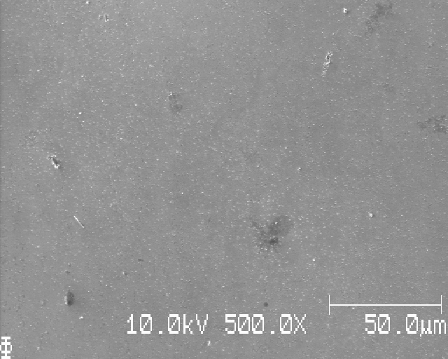
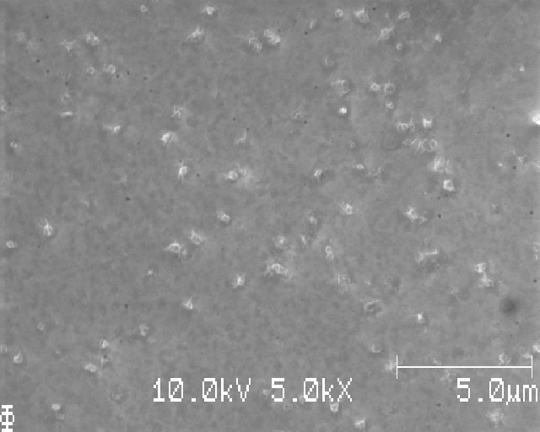
S07

Slide 20
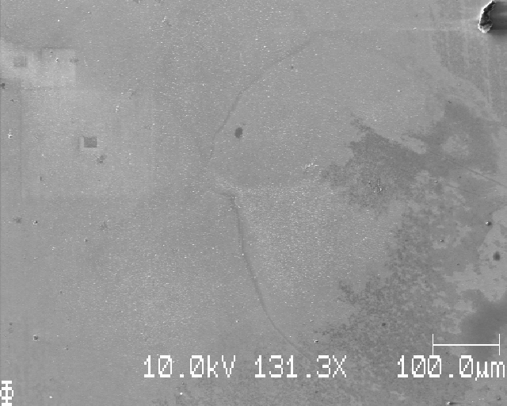
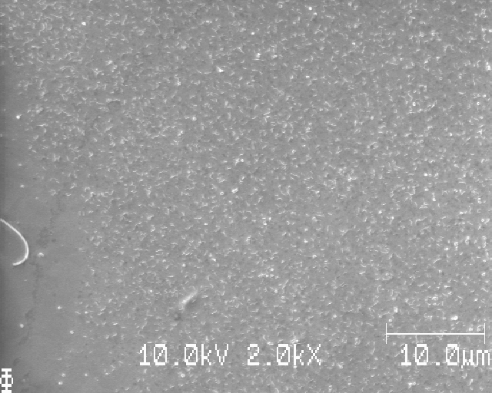
S07

Slide 21
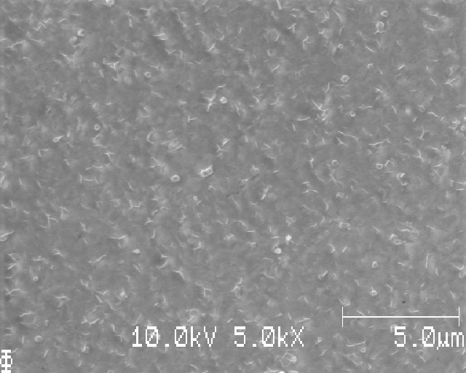
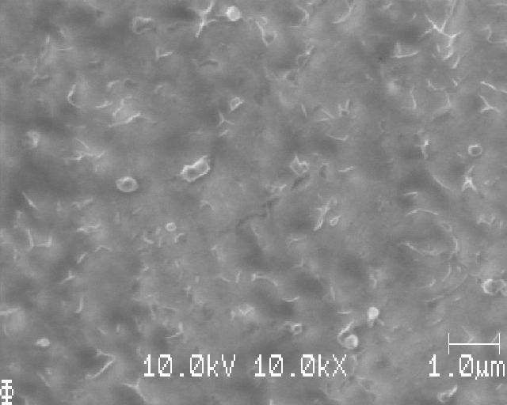
S07: same place as before; worms/needles?

Slide 22
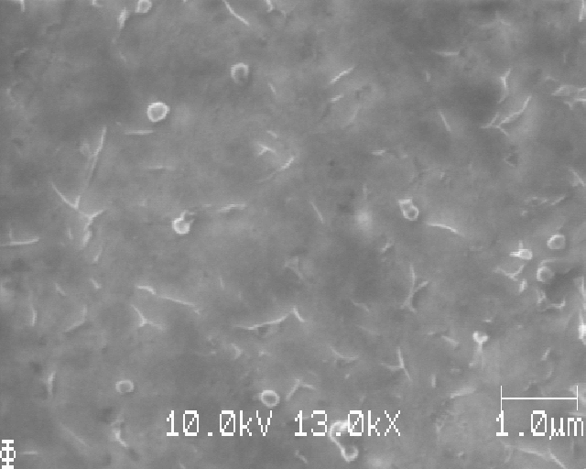
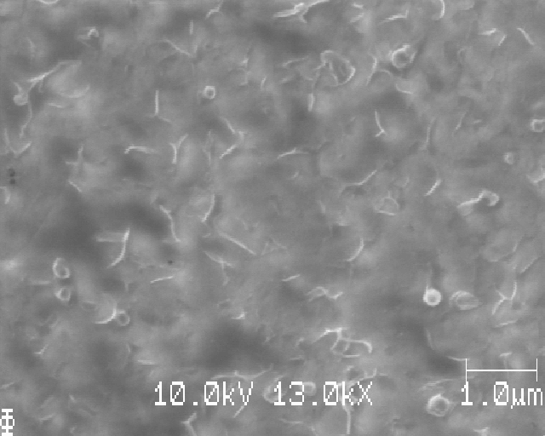
S07: same place, high mag.: close by, high mag.

Slide 23
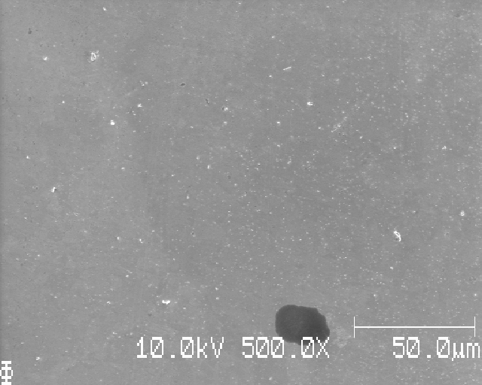
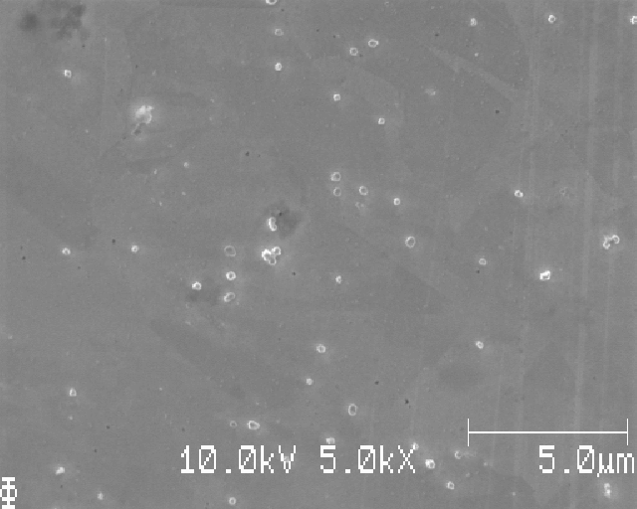
S07; further down

Slide 24
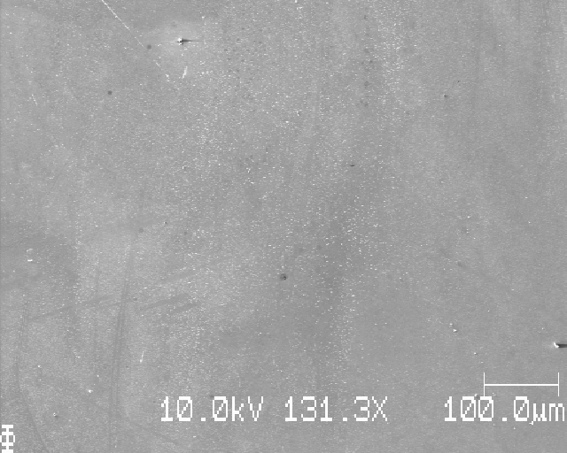
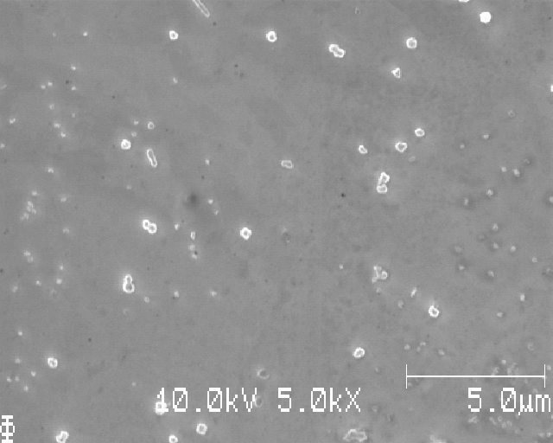
S07: another place

Slide 25
S07: learning points
Clear Li deposition at some points, even for this sample’s C0003
But only at certain regions, not true for the whole Li deposition area
However, not all Li is nice crystalline particles
Saw worms or needles (very small/short); as we saw in sample Y (master’s thesis)

Slide 26
S08_Icell_t1800_C0010_J01; (10 muAh/cm2)

Slide 27
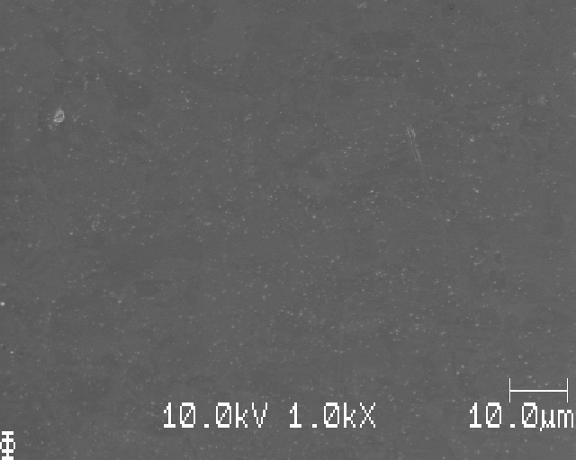
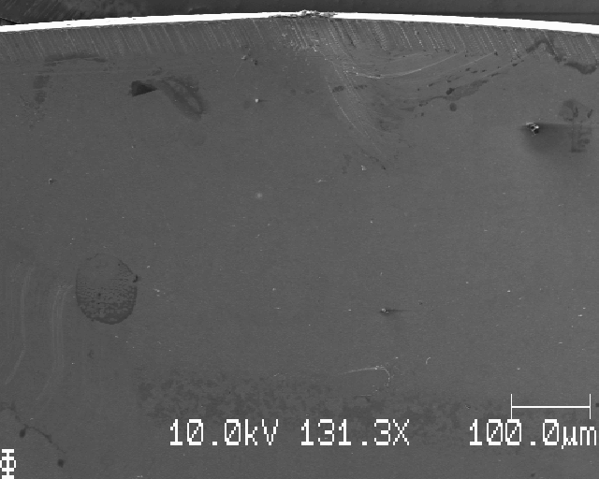
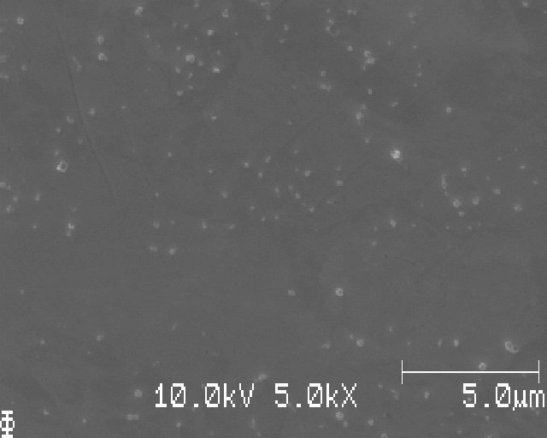
S08; at edge

Slide 28
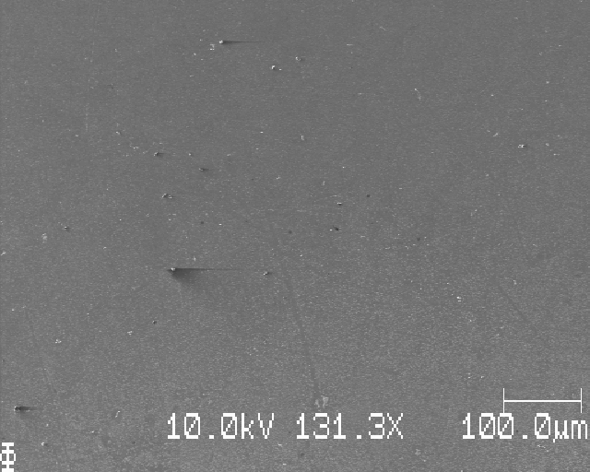
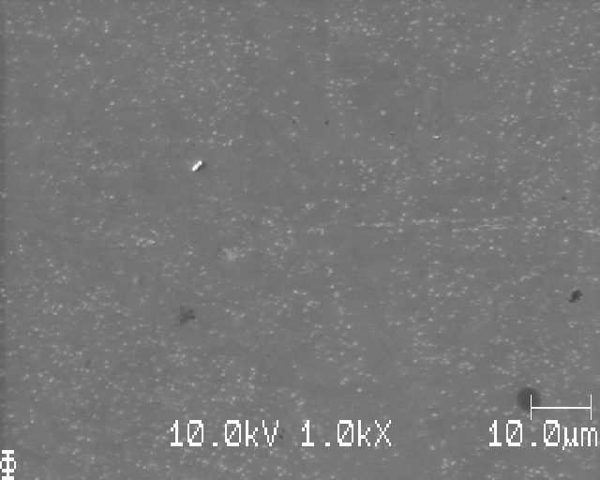
S08: down; edge of deposition

Slide 29
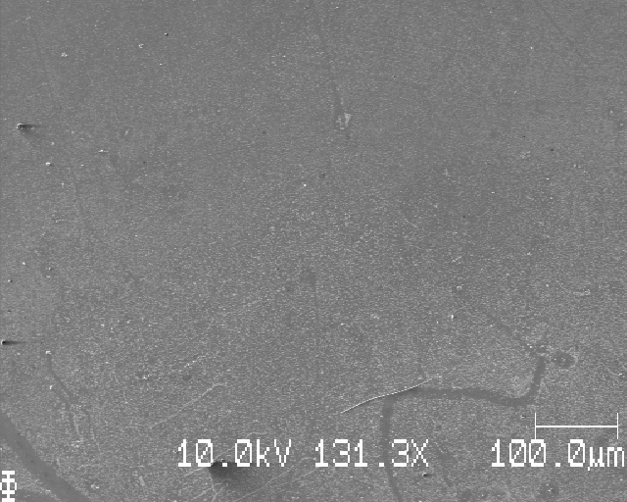
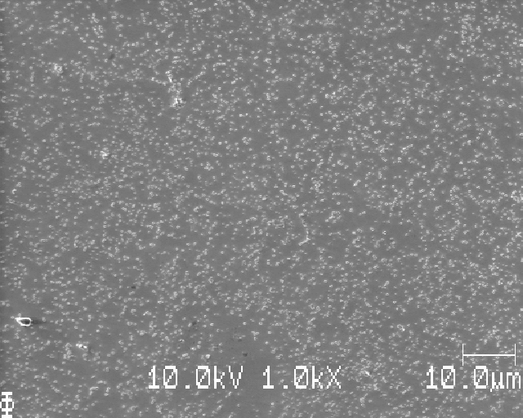
S08: down further; Li

Slide 30
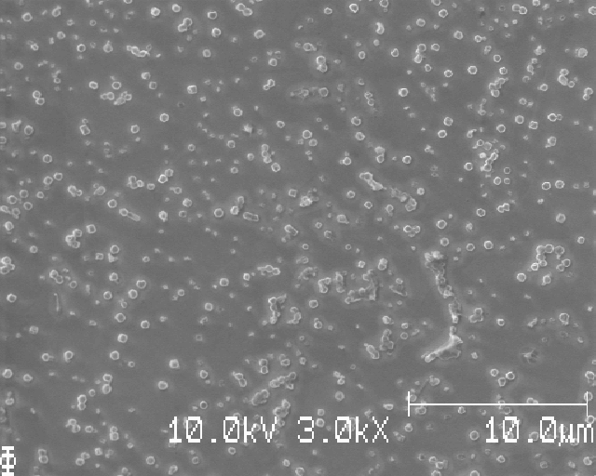
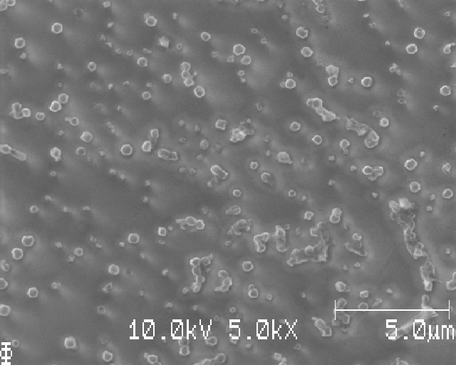
S08; same place as before; halos around Li?

Slide 31
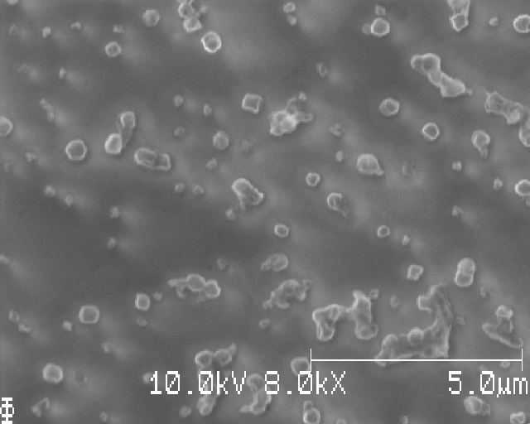
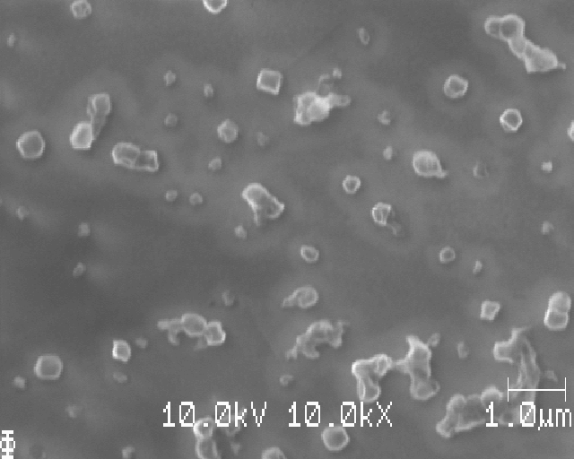
S08; same place; small Li nuclei

Slide 32
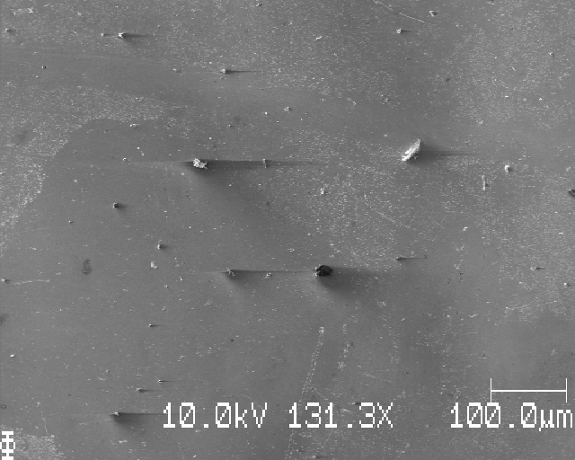
S08; further down; inhomogenous Li deposition

Slide 33
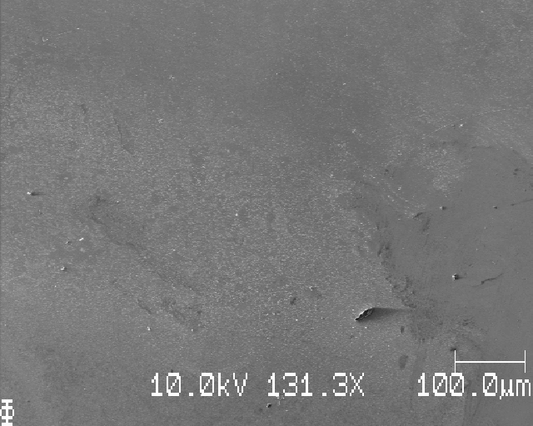
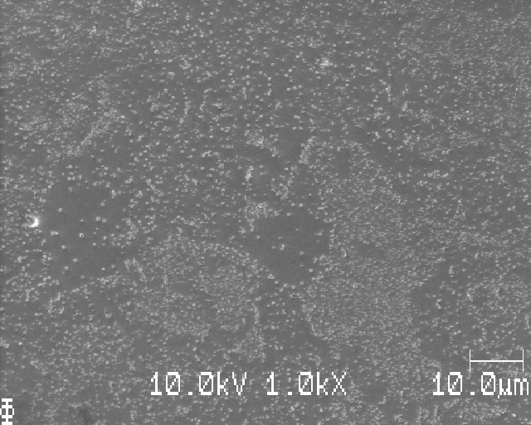
S08; further down; inhomogenous Li deposition

Slide 34
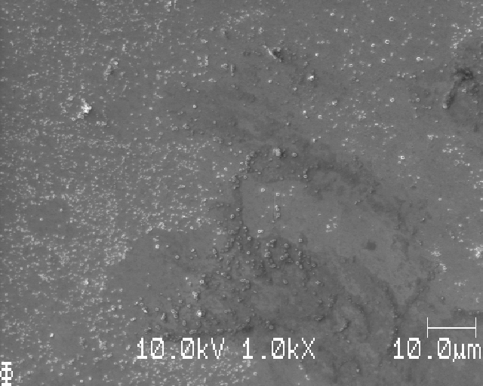

S08; slightly right of the place before

Slide 35


S08: another place; inhomogenous Li dep.

Slide 36



S08; another place, inhomogenous Li

Slide 37



S08: another place

Slide 38


S08: another place

Slide 39


S08: images for AI-training or analysis

Slide 40


S08: images for AI-training or analysis: reasonable magnification for C0010: 3k to 7k?

Slide 41


S08: images for AI-training or analysis: reasonable magnification for C0010: 4k to 6k?

Slide 42


S08: images for AI-training or analysis

Slide 43


S08: images for AI-training or analysis (several images at 6k mag.)

Slide 44


S08: images for AI-training or analysis (several images at 6k mag.)

Slide 45


S08: images for AI-training or analysis (several images at 6k mag.)

Slide 46


S08: images for AI-training or analysis (several images at 5k mag.)

Slide 47


S08: images for AI-training or analysis (several images at 5k mag.)

Slide 48


S08: images for AI-training or analysis (several images at 5k mag.)

Slide 49


S08: previous 5k/6k mag images taken in this region

Slide 50
S08: learning points
Clear Li deposition with nice crystalline particles for C0010
However, still inhomogeneous (but significantly more even than the C-cell)
Li particles have white ‘halos’ around them
Around 5k magnification might be suitable for image analysis

Slide 51
S09_Icell_t1800_C0030_J01; (30 muAh/cm2)

Slide 52

S09: top edge

Slide 53


S09; down

Slide 54

S09; down

Slide 55

S09; down, large dark region (bad clean probably, but how?) was dark all the way down

Slide 56


S09; left edge

Slide 57


S09; moving right; looks like some dirt/dark stuff too

Slide 58


S09; Li;

Slide 59


S09

Slide 60


S09; needle-growth, ‘large’ and small

Slide 61


S09: same place, Josef: might be salt. Right: more stuff that’s joined together!

Slide 62



S09: close by, large area of worms/small needles

Slide 63


S09; further right

Slide 64



S09;

Slide 65


S09; further right

Slide 66


S09; same place, more zoom (left) and then at a later time (right)

Slide 67


S09; right, bubbles when zoom

Slide 68
S09
Deposited Li for C0030
Worms/needles as we saw before - but this time very much worms and only some areas of nice particles
Bad washing in some places

Slide 69
Acquisition scheme & EP
Very hard to say where the Li deposition starts and not
Maybe manually pick a ‘center’ point and take the matrix square pictures w.r.t that center
Electropolishing seems to have made the Cu surface more smooth (almost no grinding-marks left)

